Slide 1
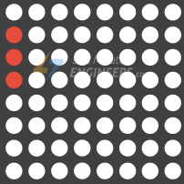
Dot Matrix
<7조>
한재욱, 엄기천

Slide 2
<음성인식기술>
A Table of Contents.
1
개요
2
구조
3
핀구성
4
코드
5
실행결과

Slide 3
1. 개요

Slide 4
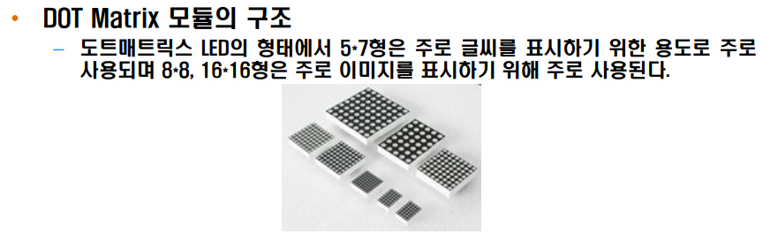
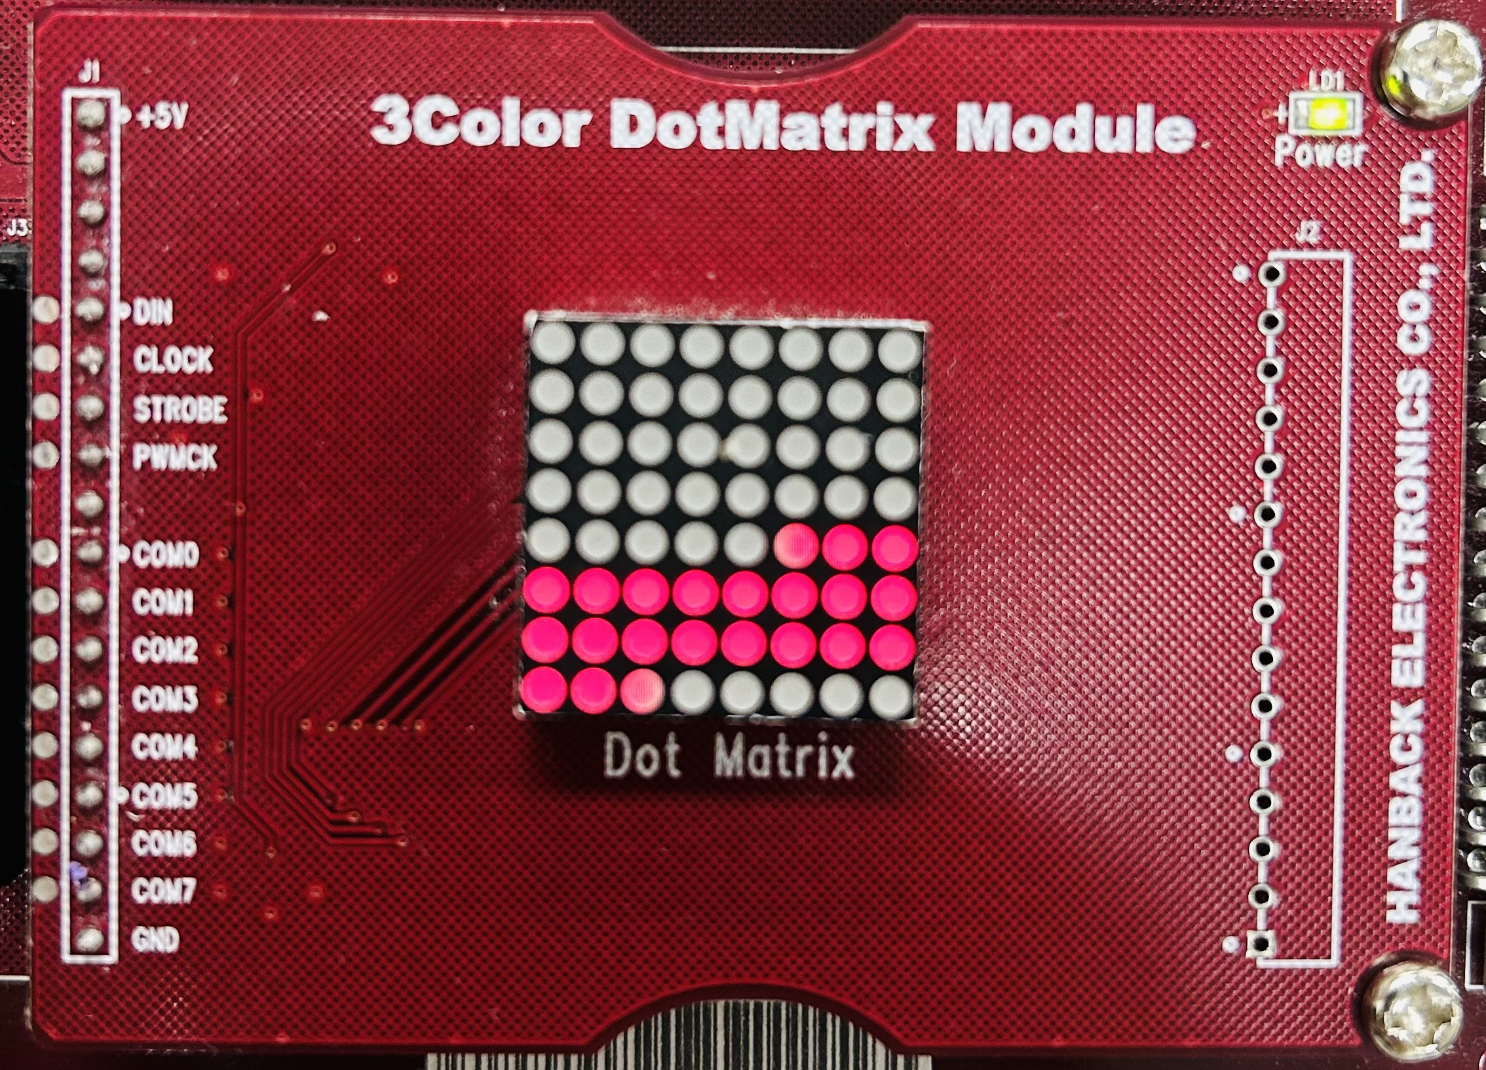
개요
← 키트에 장착된 모듈 == 8x8 Dot Matrix

Slide 5
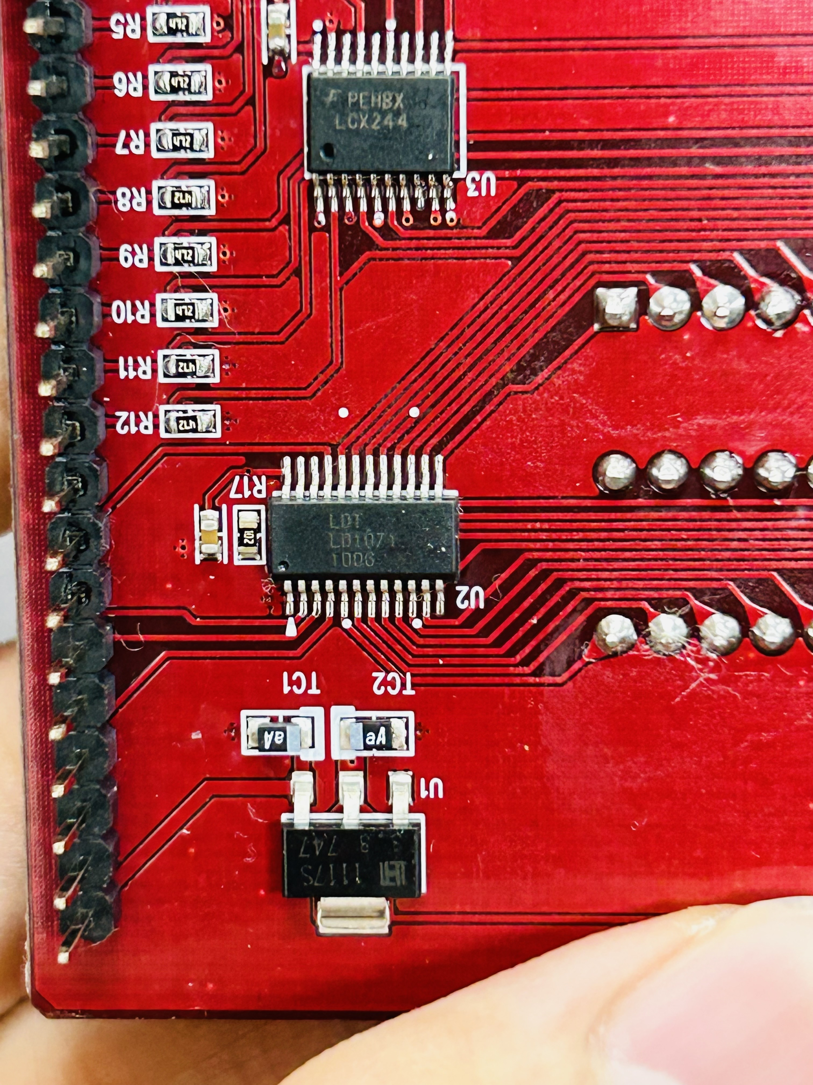
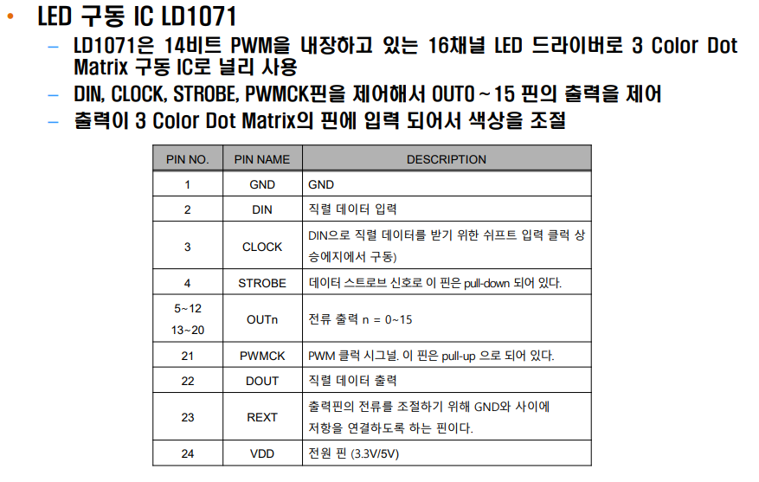
개요
LD 1071

Slide 6
2. 구조

Slide 7
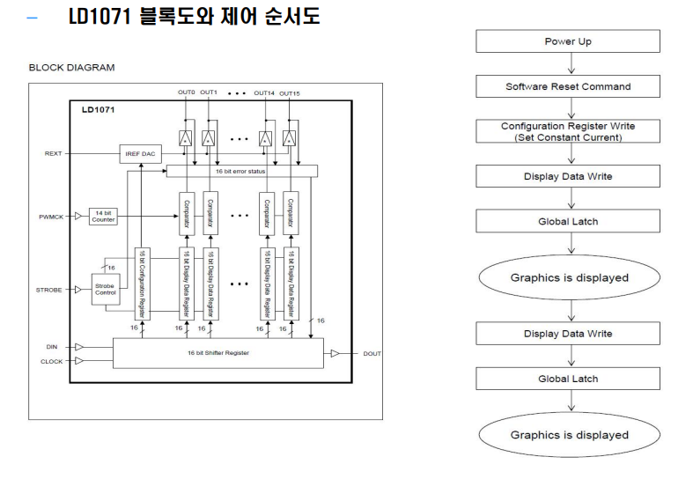
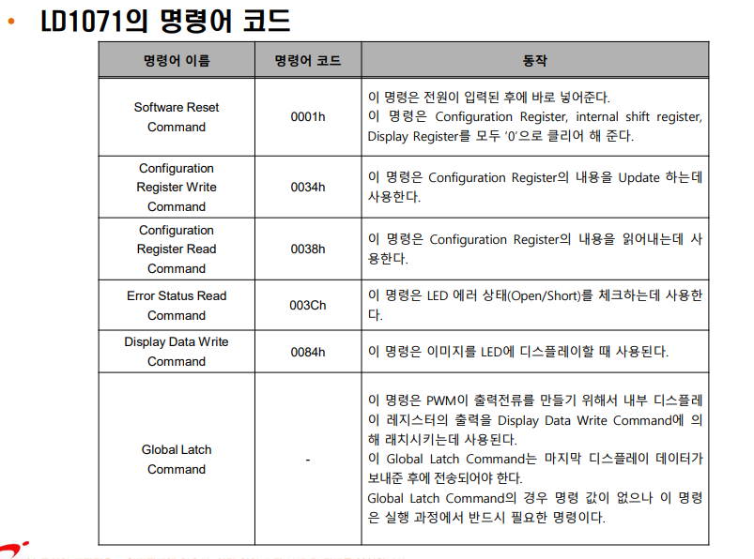
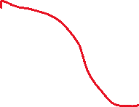
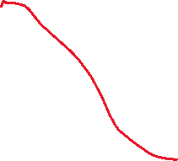


2. 구조

Slide 8
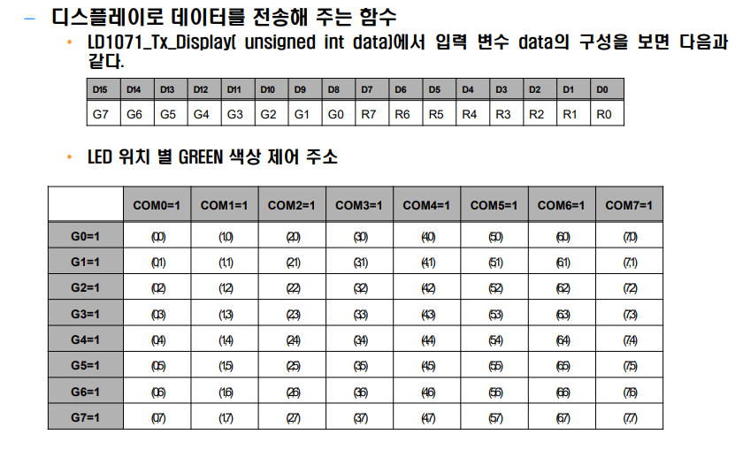
2. 구조
(00ff = red, ff00 = green, ffff = orange)

Slide 9
3. 핀구성

Slide 10
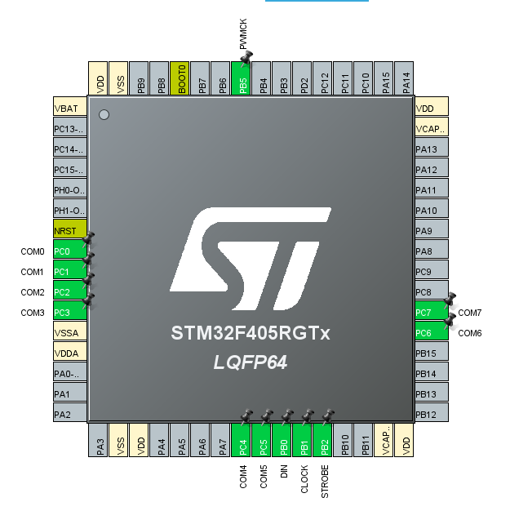
3. 핀구성
PB0~2, PB5 = OUTPUT
PC0~PC7 = OUTPUT
핀설정 이외에 다른설정 바꿀필요 x

Slide 11
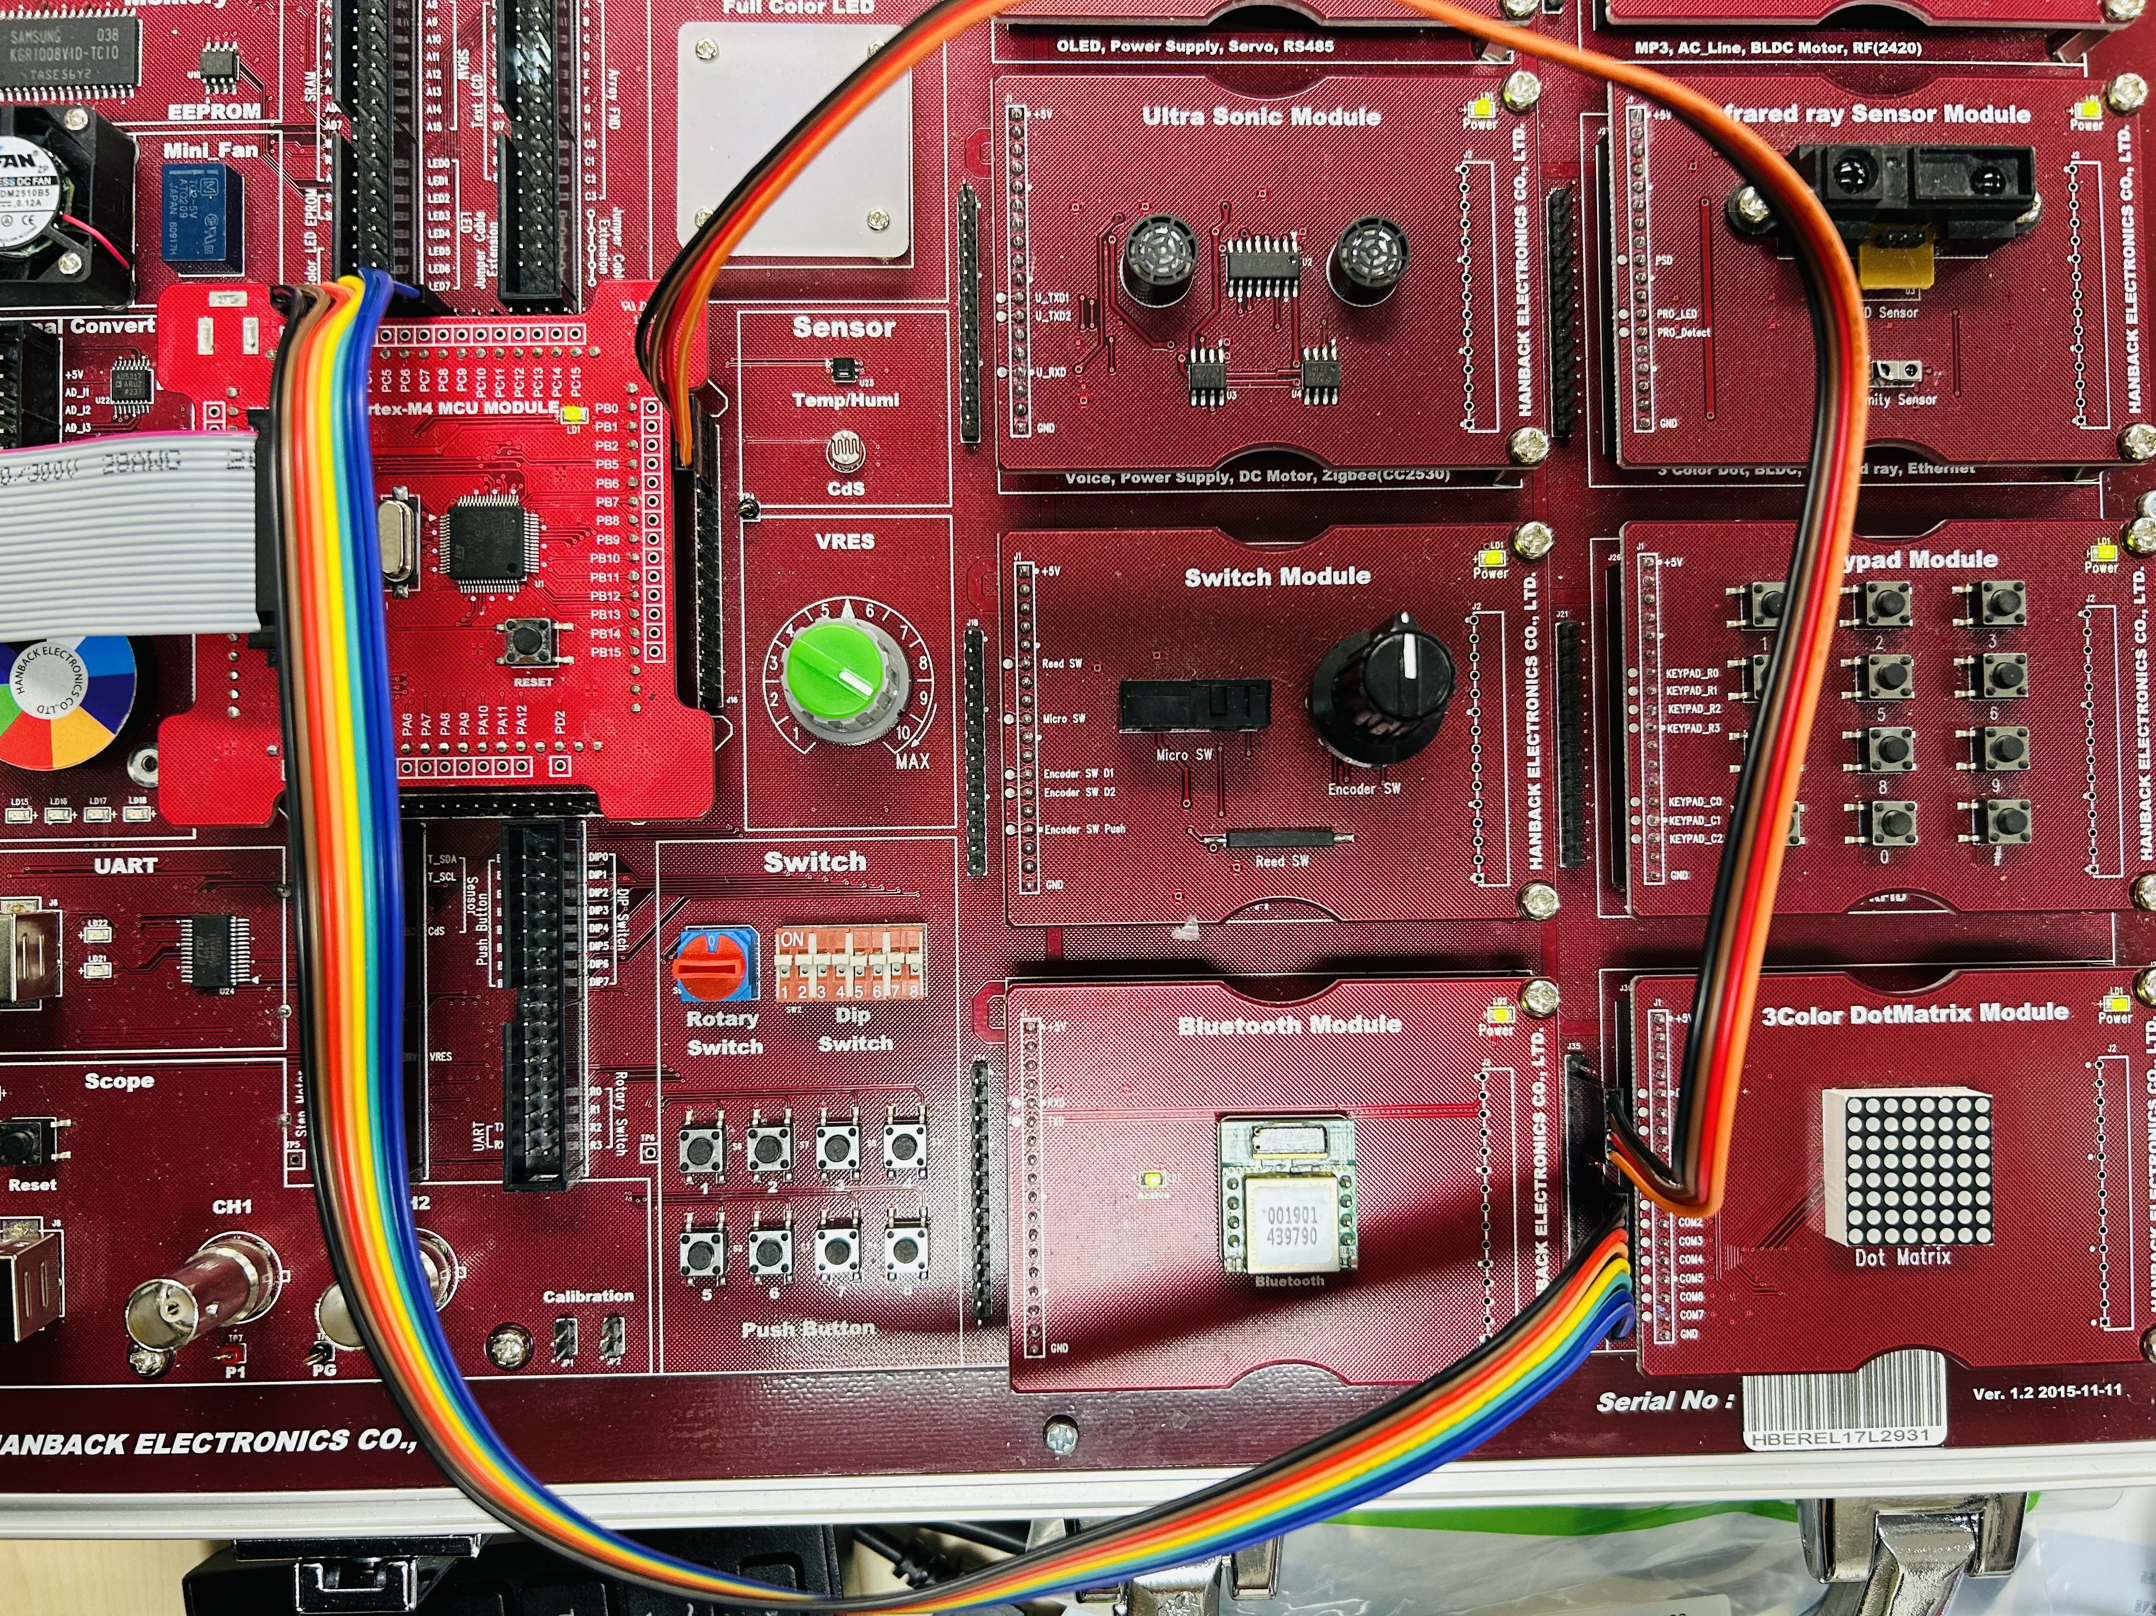
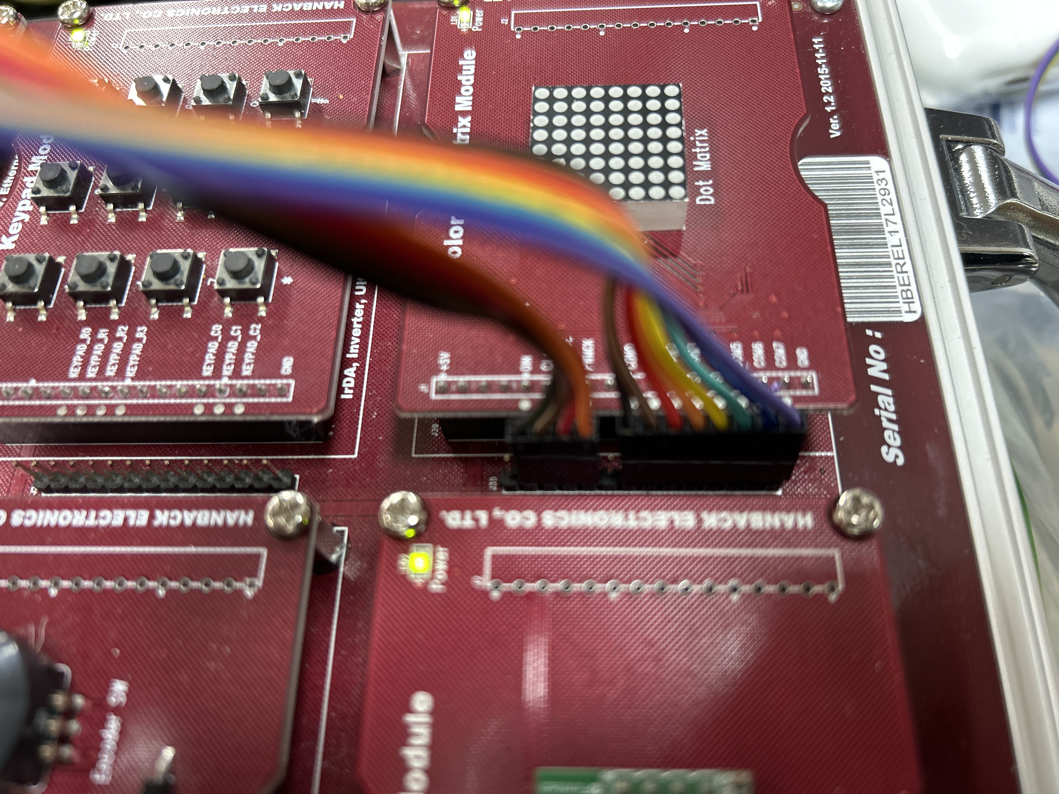


3. 핀구성
PC0 ~ PC7 = COM0 ~ COM7
DIN, CLOCK, STROBE, PWMCK = PB0 ~ PB2, PB5

Slide 12
4. 코드

Slide 13
4. 코드
/* USER CODE BEGIN 0 */
#define LD1071_DIN GPIO_PIN_0
#define LD1071_CLK GPIO_PIN_1
#define LD1071_STB GPIO_PIN_2
#define LD1071_PWM GPIO_PIN_5
void LD1071_Tx_CMD(unsigned int cmd)
{
unsigned int i = 0;
// Strobe 신호를 'high'=> PORTB.2 = 1;
HAL_GPIO_WritePin(GPIOB, LD1071_STB, 1);
// 16비트 데이터인 cmd를 D0부터 1비트씩 직렬로 전송한다.
for( i = 0 ; i< 16 ; i++ )
{
// PORTB.0 = 1;
if(cmd & 0x0001) HAL_GPIO_WritePin(GPIOB, LD1071_DIN,1);
// PORTB.0 = 0;
else HAL_GPIO_WritePin(GPIOB, LD1071_DIN,0);
// PORTB.1 = 0;
HAL_GPIO_WritePin(GPIOB, LD1071_CLK,0);
// PORTB.1 = 1;
HAL_GPIO_WritePin(GPIOB, LD1071_CLK,1);
// LSB부터 송신
cmd = cmd >> 1 ;
}
// PORTB.1 = 0;
HAL_GPIO_WritePin(GPIOB, LD1071_CLK,0);
// PORTB.2 = 0;
HAL_GPIO_WritePin(GPIOB, LD1071_STB,0);
}

Slide 14
4. 코드
void LD1071_Tx_Data(unsigned int data)
{
unsigned int i;
// PORTB.2 = 0;
HAL_GPIO_WritePin(GPIOB, LD1071_STB,0);
for( i =0 ; i < 16; i++ )
{
// PORTB.0 = 1;
if( data & 0x0001) HAL_GPIO_WritePin(GPIOB, LD1071_DIN,1);
// PORTB.0 = 0;
else HAL_GPIO_WritePin(GPIOB, LD1071_DIN,0);
// PORTB.1 = 0;
HAL_GPIO_WritePin(GPIOB, LD1071_CLK,0);
// PORTB.1 = 1;
HAL_GPIO_WritePin(GPIOB, LD1071_CLK,1);
// LSB부터 송신
data = data >> 1;
}
// PORTB.1 = 0;
HAL_GPIO_WritePin(GPIOB, LD1071_CLK,0);
// PORTB.2 = 1;
HAL_GPIO_WritePin(GPIOB, LD1071_STB,1);
// PORTB.2 = 0;
HAL_GPIO_WritePin(GPIOB, LD1071_STB,0);
}
void LD1071_Global_Latch(void)
{
unsigned int i = 0;
// PORTB.2 = 1;
HAL_GPIO_WritePin(GPIOB, LD1071_STB,1);
// PORTB.0 = 0;
HAL_GPIO_WritePin(GPIOB, LD1071_DIN,0);
for( i = 0 ; i < 9 ; i++ )
{
// PORTB.1 = 0;
HAL_GPIO_WritePin(GPIOB, LD1071_CLK,0);
// PORTB.1 = 1;
HAL_GPIO_WritePin(GPIOB, LD1071_CLK,1);
}
// PORTB.2 = 0;
HAL_GPIO_WritePin(GPIOB, LD1071_STB,0);
// PORTB.2 = 1;
HAL_GPIO_WritePin(GPIOB, LD1071_STB,1);
// PORTB.2 = 0;
HAL_GPIO_WritePin(GPIOB, LD1071_STB,0);
// PORTB.2 = 1;
HAL_GPIO_WritePin(GPIOB, LD1071_STB,1);
// PORTB.2 = 0;
HAL_GPIO_WritePin(GPIOB, LD1071_STB,0);
// PORTB.1 = 0;
HAL_GPIO_WritePin(GPIOB, LD1071_CLK,0);
}

Slide 15
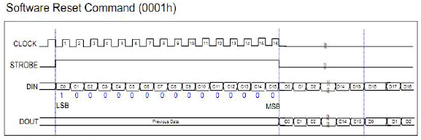
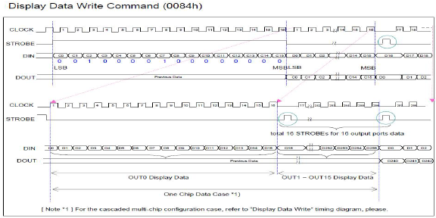
4. 코드
void LD1071_Reset(void)
{
// Software Reset Command를 전송해 준다
LD1071_Tx_CMD(0x0001);
HAL_Delay(110);
}
void LD1071_Tx_Display( unsigned int data_B, unsigned int data_C) //data_B = 좌표, data_C = 행
{
unsigned int i , mask = 0x0001;
LD1071_Tx_CMD( 0x0084);
for(i = 0 ; i <16 ; i++)
{
if(data_B & mask ) LD1071_Tx_Data(0xFFFF);
else LD1071_Tx_Data(0x0000);
mask = mask << 1;
}
LD1071_Global_Latch();
HAL_GPIO_WritePin(GPIOC, data_C,1);
HAL_Delay(0);
HAL_GPIO_WritePin(GPIOC, 0xff,0);
}

Slide 16
4. 코드
/* USER CODE BEGIN 2 */
//초기화
LD1071_Reset();
HAL_GPIO_WritePin(GPIOB, LD1071_PWM, 1);
HAL_GPIO_WritePin(GPIOC, 0xff,0);
// Configuration Register Update Command
LD1071_Tx_CMD(0x0034);
// Configuration Register
LD1071_Tx_Data(0x04FF);
/* USER CODE END 2 */
//알파벳 A
for(int i=0; i<300; i++){ //출력 갯수당 1ms의 속도를 가짐, 300이면 300*(갯수)ms
LD1071_Tx_Display(0x0018, 0x01); //열00011000, 행1
LD1071_Tx_Display(0x0024, 0x02); //열00100100, 행2
LD1071_Tx_Display(0x0042, 0x04); //열01000010, 행3
LD1071_Tx_Display(0x0042, 0x08); //열01000010, 행4
LD1071_Tx_Display(0x007e, 0x10); //열01111110, 행5
LD1071_Tx_Display(0x0042, 0x20); //열01000010, 행6
LD1071_Tx_Display(0x0042, 0x40); //열01000010, 행7
LD1071_Tx_Display(0x0042, 0x80); //열01000010, 행8
}
for(int i=0; i<38; i++){ // 문자 데이터 호출
for(int k=1; k<100; k++){ //출력 갯수당 1ms의 속도를 가짐, 300이면 300*(갯수)ms
LD1071_Tx_Display(disp1ay[i][0], 0x01); //열 i, 행1
LD1071_Tx_Display(disp1ay[i][1], 0x02); //열 i, 행2
LD1071_Tx_Display(disp1ay[i][2], 0x04); //열 i, 행3
LD1071_Tx_Display(disp1ay[i][3], 0x08); //열 i, 행4
LD1071_Tx_Display(disp1ay[i][4], 0x10); //열 i, 행5
LD1071_Tx_Display(disp1ay[i][5], 0x20); //열 i, 행6
LD1071_Tx_Display(disp1ay[i][6], 0x40); //열 i, 행7
LD1071_Tx_Display(disp1ay[i][7], 0x80); //열 i, 행8
}
}
/* USER CODE BEGIN WHILE */
while (1)
{
/* USER CODE END WHILE */
// Green
for(int i=0; i<2400; i++){//출력 갯수당 1ms의 속도를 가짐
LD1071_Tx_Display(0xff00, 0xff);
}
// RED
for(int i=0; i<2400; i++){//출력 갯수당 1ms의 속도를 가짐
LD1071_Tx_Display(0x00ff, 0xff);
}

Slide 17
5. 실행결과

Slide 18
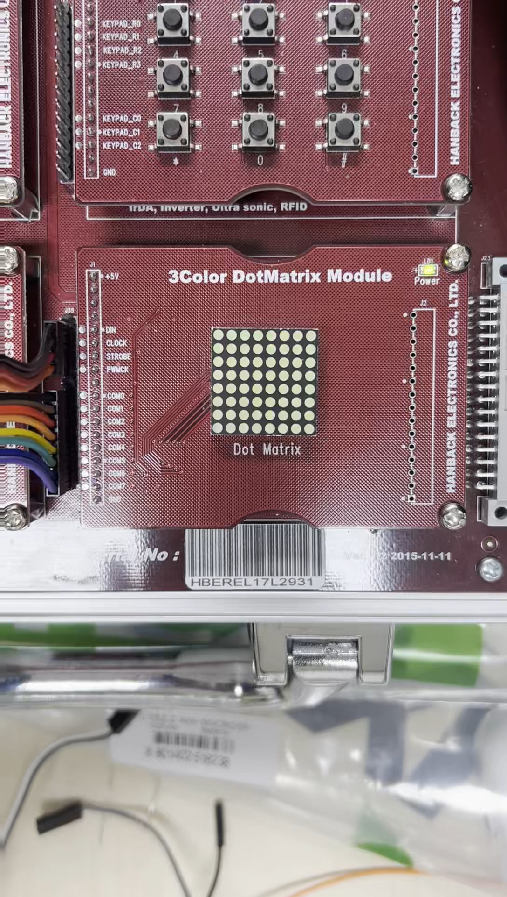
5. 실행결과

Slide 19
Thank you!

